Slide 1






The Borzoi Encyclopedia
Home Encyclopedia Collections Events Storytellers Club forums Media Wall of Honor Maps
Tables:
Encyclopedia. Show All content in the database via index?
People. Uses: Gender, Dogs, Kennel. If kennel or dog not in file, open add form.
Dogs. Uses: Gender, Kennel, Breeder/owner (people), Titles, Color and Studbooks.
Events. Uses: Place (maps?), people, dogs
History. Uses: People, Dogs, Events
Historic collection. Uses: People, Dogs, Events. (Mother/child form) One event many histories.
Storyteller. Uses: People, Dogs, Events. One person, many stories.
Book/magazine Present book. Chapters and pages.
Art Borzoi related art, People, Dogs, Places
Club forums. Link to club site. Further link to club activities, link to club Newsletter?
Media. Support: Link to related pages on social media
Wall of Honor. Support: People, link to contact page.
Contact page. Contakt via social media, e-mail, one, group or all. Blog, Forum?

Slide 2
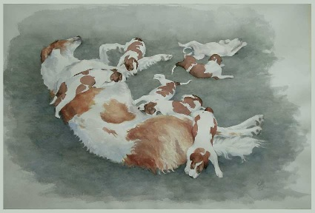
The Borzoi Encyclopedia
Menu Encyclopedia Collections Events Storytellers Club forums Media Wall of Honor Maps
To do:
New Front page theme. Allow full page, menues for visitors, adverts on the bottom. Eventually as a banner. Easy change of front picture and logo.
Menu in three steps: Menu for visitors, next for members/authors and third for editors, eventually Borzoi editor
Lists. Save and publish/unpublish. Unknown parents should go to the review parents list and not be published to the Add borzoi list. Check how flags has been set and where they point.
Relations between Kennel, Owner/person and dogs. Click Kennel, see owners, click Owner and see dogs. Click person and see kennel relations and dogs.
Import from Studbook direct in to the Add borzoi page? Check birthdate, breeder/owner and parents?
Collections, Protocol, Club forums, Personal story. Decide if initiate from menu or from a list. Make a model of Mother and Child views/forms/blocks that can be reused!
Titles! If a dog has titles, show or field, show only Ch in pedigrees/offspring but all titles in the presentation.
Color! Room for improvements. Not very onsistent and logical now!
Eventually add external pedigree and offspring charts (pedigree point), use pictures in pedigrees?
Maps with hotspots – places, famous kennels etc.

Slide 3
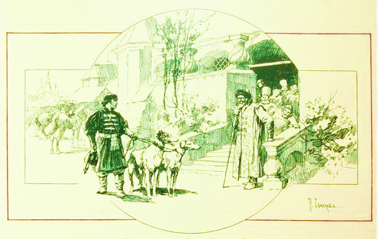
The Borzoi Encyclopedia
Log in
Home Encyclopedia Collections Events Storytellers Club forums Media Wall of Honor Maps
New member
About us
This is what meet the visitor!
Must decide what the visitor am allowed to see from the topline menu

Slide 4
The Borzoi Encyclopedia
Log in
Menu Encyclopedia Collections Events Storytellers Club forums Media Wall of Honor Maps
Log in
New member
About us
Studbooks
Kennels
Breeders and Owners
Add content
Borzoi
History
Art
Books
My account
Log out
This is what the members see when logged in.

Slide 5
The Borzoi Encyclopedia
Log in
Home Encyclopedia Collections Events Storytellers Club forums Media Wall of Honor Maps
Log in
New member
About us
Studbooks
Review unpublished
Review parents
Review imports
Kennels
Breeders and Owners
Guides/help
Add content
Borzoi
History
Art
Collection
Event
Personal story
More
My account
Log out
The menu Authors/Editors sees. Gives access to adding content to the database!

Slide 6
The Borzoi Encyclopedia
Log in
Home Encyclopedia Collections Events Storytellers Club forums Media Wall of Honor Maps
Log in
New member
About us
Studbooks
Review unpublished
Review parents
Review imports
Kennels
Breeders and Owners
Guides/help
Add content
Borzoi
History
Art
Collection
Event
Personal story
More
My account
Log out
This is for Borzoi Editor and Admin?
Borzoi editors can add new and edit the content in all lists and tables. Can not change code or alter the behavior of the program.
More.. Add new/Edit
Members
Clubs
E-mail
Media
Guides/help
Front page images
Color, Marking, Attributes
Gender
Moore..

Slide 7
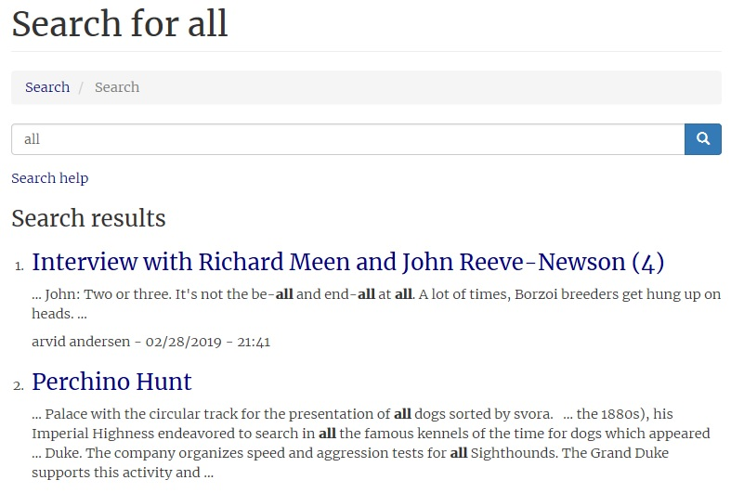
The Borzoi Encyclopedia
Log in
Menu Encyclopedia Collections Events Storytellers Club forums Media Wall of Honor Maps
A B C D E F G H I J K L M N O P Q R S T U V X Y Z Ä Ö Å
Search the Encyclopedia
Latest additions
All content
Borzoi
Borzoi history
Borzoi in art
Kennels
People
This is the challenge, how to make the Encyclopedia act like an encyclopedia.
In Borzoipedigree.com they use an alphabetical line on top and select from each letter. Our problem is that there can be thousand names on same letter. To scroll for that many is not an option but perhaps a search based on the selected letter!
Richard Meen and John Reeve-Newson (1)
Richard Meen and John Reeve-Newson (2)
Richard Meen and John Reeve-Newson (3)
Richard Meen and John Reeve-Newson (4)
R
R
R
Search: Rich

Slide 8
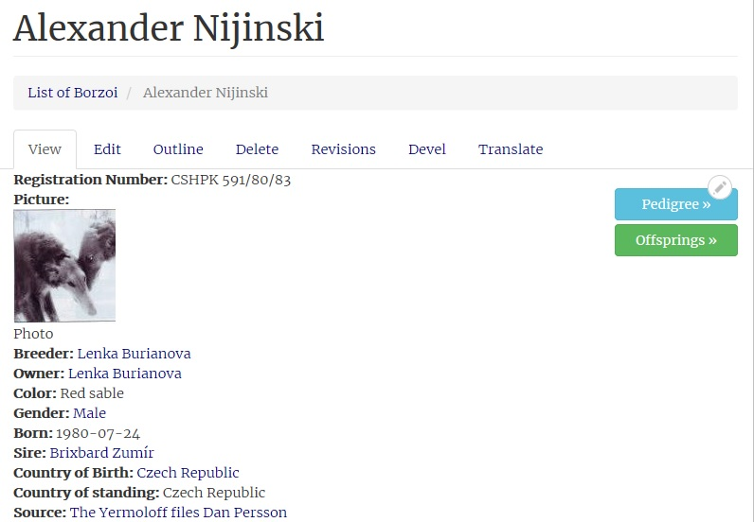
The Borzoi Encyclopedia
Log in
Menu Encyclopedia Collections Events Storytellers Club forums Media Wall of Honor Maps
A B C D E F G H I J K L M N O P Q R S T U V X Y Z Ä Ö Å
Search the Encyclopedia
Latest addions
All content
Borzoi
Borzoi history
Borzoi in art
Kennels
People
Search: Alexander
Ada
Agda
Aida
Akita
Alexander Nijinski
Alma von Hintenburger
Amina
Anna

Slide 9
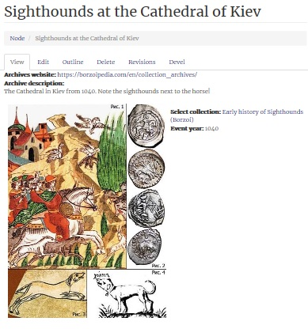
The Borzoi Encyclopedia
Log in
Menu Encyclopedia Collections Events Storytellers Club forums Media Wall of Honor
Collections Search Add new
Search: Add new
Barnaigh collection
Early history of sighthounds (borzoi)
Ekhaga archives
Martynov portfolio
Small hunters in the Tzars Russia
Tam-Boer portfolio
Zomahli collection
Click for full page
Add new
Search:
. Sighthounds at the Cathedral of Kiev , 1040
. The Bayeux Tapestry 1100
. Woodcarving on Church door in Norway 1150

Slide 10
The Borzoi Encyclopedia
Log in
Menu Encyclopedia Collections Events Storytellers Club forums Media Wall of Honor Maps
Search: Cruft
Borzoipedia Seminar 2021 in Croatia - Invitation
Report from Crufts 2019
Report from Westminster 2019
Report from the European Lure coursing Championship 2018

Slide 11

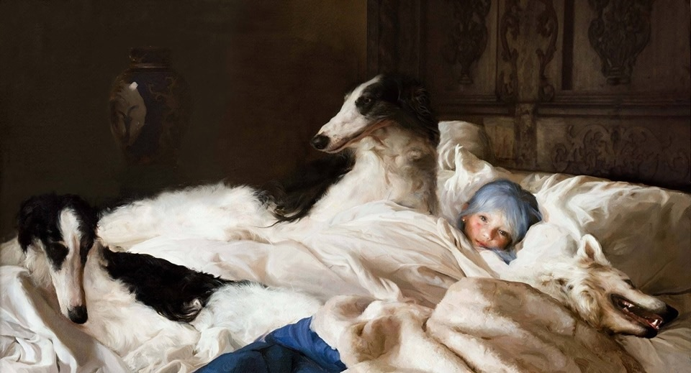
Log in
Menu Encyclopedia Collections Events Storytellers Club forums Media Wall of Honor Maps
Search: Estes
Sara Forsberg’s column
Catherine Estes diaries
2019-09-08

Slide 12
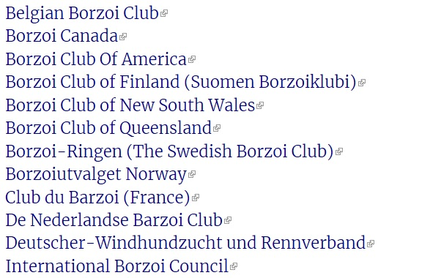
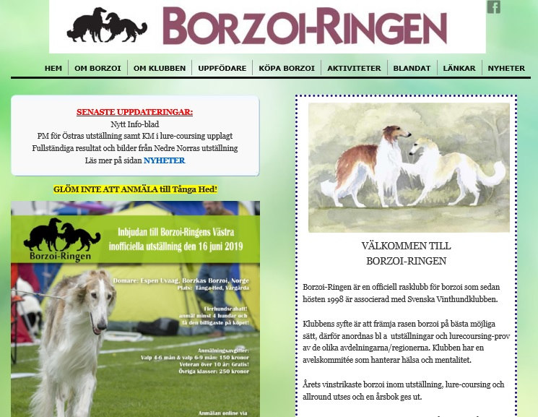
The Borzoi Encyclopedia
Log in
Menu Encyclopedia Collections Events Storytellers Club forums Media Wall of Honor Maps

Slide 13
The Borzoi Encyclopedia
Log in
Menu Encyclopedia Collections Events Storytellers Club forums Media Wall of Honor Maps
Facebook
Tvitter
Youtube
Sighthound magazines
Books
We have discussed to purchase an overhead scanner with OCR to scan books and magazines. Eventually some sort of Pay per View.
The Borzoi Handbook Winifred E. Chadwick
The Complete Borzoi
Svenska Champions 1900 – 1999
Svenska Borzoiringens Jubileumsbok 1971 - 1981

Slide 14
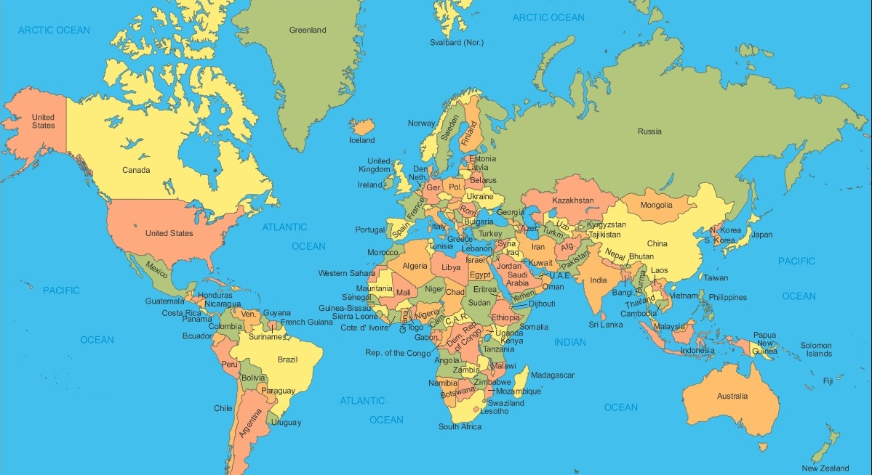
The Borzoi Encyclopedia
Log in
Menu Encyclopedia Collections Events Storytellers Club forums Media Wall of Honor Maps.
All
Africa
America North
America South
Asia
Australia
Europe
Russia
Hotspots to mark known places, Perchino?
Easy change of frontpage picture

